Slide 1

ALY6080 - Integrated Experiential Learning GE Aviation
GROUP 4
Group Members:
Vishruta Makhija
Mohit Patel
Keyur Shah
Duc Anh Nguyen
Sneha Gupte

Slide 2
GE Aviation Overview
Operating Unit of GE
Leading supplier of jet and turboprop engines, parts, and integrated solutions for aerospace, military, civil and general aviation aircraft
Revenue for the Financial Year 2019: USD 32.88 billion
Employee strength of nearly 48,000 (as of 2018)

Slide 3
GE Aviation Purpose & Goal
Purpose: Protection of GE’s Intellectual Property
Current System: Digital Guardian
Goal: Analyze the current Alert System Data and create predictive models that will help GE to manage their alert system and prevent IP Thefts.

Slide 4

Business Objectives
Minimize High-risk transactions that are predicted to be Low-risk, i.e. minimize False Negative
Minimize the number of transactions to be reviewed, i.e. minimize False Positive
Predictive model with high re-usability with transaction data updated continuously.

Slide 5
Data Preparation
Delete duplicates from Employee Data.
Replacing the missing values in Country, function group column.
Calculation of Tenure, the gap between escalated and insert date
Combining Employee Data, BN Data and Heat Score Data

Slide 6
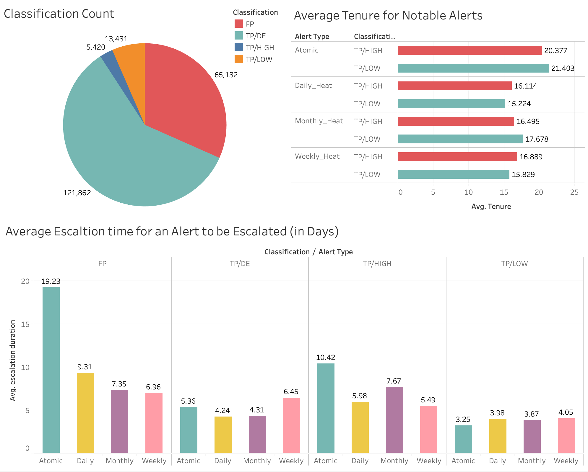
Exploratory Data Analysis

Slide 7

Unsupervised Learning Algorithm
Unsupervised learning is a type of machine learning algorithm used to draw inferences from datasets consisting of input data without labeled responses.
The most used unsupervised learning method is cluster analysis, which is used for exploratory data analysis to find hidden patterns or grouping in data.
It is often used to preprocess the data by compressing it in meaningful way to identify important features before applying the supervised learning algorithm.

Slide 8

K-means Clustering Algorithm
K-means clustering is one of the popular unsupervised machine learning algorithms
A cluster refers to a collection of data points aggregated together because of certain similarities

Slide 9
Unsupervised Learning Atomic Alerts
CLUSTERS | Alert Count | Classification FP | Classification TP/DE | Classification TP/HIGH | Classification TP/LOW
0 | 7327 | 17.34% | 71.93% | 0.42% | 10.31%
1 | 21888 | 77.26% | 22.64% | 0.00% | 0.10%
2 | 2333 | 6.82% | 43.98% | 2.40% | 46.81%
3 | 19719 | 98.51% | 1.31% | 0.00% | 0.18%
4 | 562 | 30.25% | 54.27% | 2.14% | 13.35%
5 | 9244 | 66.81% | 30.91% | 0.55% | 1.73%
6 | 19628 | 3.90% | 93.89% | 0.12% | 2.08%
7 | 3332 | 99.73% | 0.12% | 0.06% | 0.09%
8 | 4295 | 73.83% | 23.86% | 0.61% | 1.70%
9 | 4262 | 46.79% | 50.87% | 0.52% | 1.83%
Optimum Number of Clusters found 10
High Risk generating Factors were:-
Career Band Analyst_1, Analyst_4, Analyst_6, Analyst_7, Analyst_8, Analyst_10
Indicator source app 12, 13, 9 were the risk features
HRU 5, HRU 11, HRU 13 were risk feature to trigger critical risk alarm
China, Mexico are likely to trigger critical risk alarm
Job Function 6, 7, 8, 16, 18 were the critical features

Slide 10
Unsupervised Clustering Threshold Alerts
Daily_Heat Alerts
Weekly_Heat Alerts
Monthly_Heat Alerts

Slide 11
Weekly Heat
CLUSTER | Alert Count | Classification FP | Classification TP/DE | Classification TP/HIGH | Classification TP/LOW
0 | 2361 | 18.01% | 57.90% | 13.42% | 10.66%
1 | 11 | 0.00% | 100.00% | 0.00% | 0.00%
2 | 30804 | 8.86% | 76.56% | 4.83% | 9.75%
3 | 286 | 0.00% | 87.06% | 0.00% | 12.94%
4 | 106 | 0.00% | 57.55% | 16.98% | 25.47%
5 | 415 | 0.00% | 76.39% | 5.78% | 17.83%
6 | 25 | 0.00% | 0.00% | 0.00% | 100.00%
7 | 620 | 3.71% | 46.77% | 17.26% | 32.26%
Optimal Number of Clusters:- 8.
The factors owner_analyst_6 and 7, HRU11, indicators_App_13_Heat_USB_IND, job_function_JOB_FUNCTION_13 and 7 falls under critical groups.
The countries that violate IP are China, Malaysia and US.

Slide 12
Daily Heat
CLUSTER | Alert Count | Classification FP | Classification TP/DE | Classification TP/HIGH | Classification TP/LOW
0 | 32612 | 0.00% | 100.00% | 0.00% | 0.00%
1 | 8 | 9.74% | 78.73% | 3.30% | 8.24%
2 | 67 | 0.00% | 72.04% | 6.45% | 21.51%
3 | 690 | 0.00% | 100.00% | 0.00% | 0.00%
4 | 14 | 6.45% | 72.79% | 6.12% | 14.64%
5 | 2817 | 0.00% | 50.00% | 0.00% | 50.00%
6 | 24 | 10.97% | 38.87% | 24.45% | 25.71%
7 | 36 | 17.79% | 70.35% | 4.23% | 7.63%
8 | 6 | 0.00% | 100.00% | 0.00% | 0.00%
9 | 99 | 0.00% | 50.00% | 0.00% | 50.00%
10 | 329 | 4.23% | 76.09% | 5.10% | 14.58%
11 | 915 | 6.90% | 68.97% | 2.30% | 21.84%
Optimal Number of Clusters:- 12.
The highest risk generating factors are:- owner_name_Analyst_7, HRU2, CAREER_BAND_10, Job_Function7, BUSINESS_SEGMENT_4
US,UAE and Mexico violates IP.

Slide 13
Monthly Heat
CLUSTER | Alert Count | Classification FP | Classification TP/DE | Classification TP/HIGH | Classification TP/LOW
0 | 35905 | 11.27% | 76.33% | 3.95% | 8.45%
1 | 372 | 0.00% | 11.29% | 26.08% | 62.63%
2 | 317 | 21.77% | 46.69% | 13.56% | 17.98%
3 | 421 | 6.89% | 40.62% | 25.65% | 26.84%
4 | 12 | 100.00% | 0.00% | 0.00% | 0.00%
5 | 2797 | 12.06% | 71.09% | 7.05% | 9.80%
6 | 40 | 10.00% | 0.00% | 0.00% | 90.00%
7 | 1144 | 24.39% | 67.83% | 0.96% | 6.82%
Optimal Number of Clusters:- 8.
CAREER_BAND_2 and 6, SHARED_INDICATOR_ACTIVITY_USB, person_type_EMPLOYEE, indicators_App_1_Heat_USB_PRE_2016_Q3, indicator_source_App_7, BUSINESS_SEGMENT_4 are the factor which are responsible for maximum heat generation.
US and China violates IP immensely.

Slide 14
Predictive Modeling
Features Selection
Training Models
Measure Models

Slide 15
Features Selection
Chi-square test of Independence
Test the hypothesis whether variables after one-hot encoding are independent to classification.
Choose the associated variables with the classification.
Random Forest
Measure the relative important of variables on classification.
Choose top 100 features.
=> Combine list of important features for each alert category (Daily Heat, Weekly Heat, Monthly Heat)

Slide 16
Training Models
Standardize data on the scale of 0 to 1
Split data into training and testing dataset, 80% and 20% respectively.
Resample training dataset: oversampling minor part to 50% of major part
Train models using Logistic Regression, Decision Tree, Random Forest, Naive Bayes.
Example: Daily Heat (Notable-risk)
Model | TN | FN | FP | TP | MSE
Logistic Regression | 5827 | 339 | 768 | 590 | 0.147
Decision Tree | 6463 | 120 | 132 | 809 | 0.033
Random Forest | 6480 | 121 | 115 | 808 | 0.031
Naive Bayes | 5415 | 355 | 1180 | 574 | 0.204

Slide 17
Measure Models
Optimize Threshold values by using the ROC graph.
Minimize FN
Precision larger than 60%
Optimal Threshold values:
 | High-Risk | Notable-Risk
Atomic | 0.1 | 0.01
Daily Heat | 0.09 | 0.17
Weekly Heat | 0.1 | 0.11
Monthly Heat | 0.09 | 0.1

Slide 18
Measure Models: Testing Data
Existing Notable Risk Model
New Notable Risk Model
 | 0 | 1
0 | 24,285 TN | 13,137 FP
1 | 0 FN | 3,748 TP
 | 0 | 1
0 | 35,004 TN | 2,418 FP
1 | 79 FN | 3,669 TP

Slide 19
Benefits of the New Model on the entire data
Reduce 52,000 False Positive.
If each analyst can review 20 transactions per day, existing system needs 6 analysts in 2 years, the new model only needs 2 analysts.
Generate total 390 False Negative.
If 0.1% of Notable Risk can really violate the IP, chance to 01 activity in False Negative: 2%, chance 02 activities in False Negative: 0.04%, chance 03 activities in False Negative: 0.0008%.

Slide 20
Insights (What and How)
High analysis and escalation periods of False Positives alerts may lead to failure in recovery of loss in IP’s.
01
Missing Logic and additional conditions in the existing alert system leading to high false positive alerts.
02
Classification model considering either high precision or high recall will cause imbalance so the right metric would be F1 score.
03

Slide 21
Recommendations
Must apply a differentiating factor or rule condition.
Before constraining the rule, it must be tested silently.
Evaluation on the duration of the false positive alert investigation.
Must consider F1 measure instead of recall or precision.
Shut down non-functional systems, performing patches on systems that are vulnerable, Network Traffic Limitations, Assets Knowledge, Insider risk management infrastructure.
High Risk and Low Risk groups must be further set in group policy based on various segments such as the Projects, Roles, Departments, Access levels for an organized alert system.
Right amalgamation of automation tools, strategy and people will strengthen GE Aviation’s defenses and save costs.

Slide 22
Deliverables
Presentation Slideshow
Tableau Dashboard
Python Notebook
Memo
Link

Slide 23

Thank You!

